Slide 1






ENHANCING ENDOSCOPIC PROCEDURE ANALYSIS
A COMPREHENSIVE STUDY ON ANOMALY DETECTION, SEGMENTATION AND CLASSIFICATION
Master Internship
Master in Science and Technology: Computer and Mobile Systems
KARIM EL HOUMAINI
Project supervised and Presented In Front Of:
Pr. ZOUHAIR Abdelhamid (FSTT Advisor) Ms. KAMMAS Chaimaa (External Advisor)
Pr. EL BRAK Mohamed (President) Pr. EN-NAIMI el mokhtar (Examiner)

Slide 2
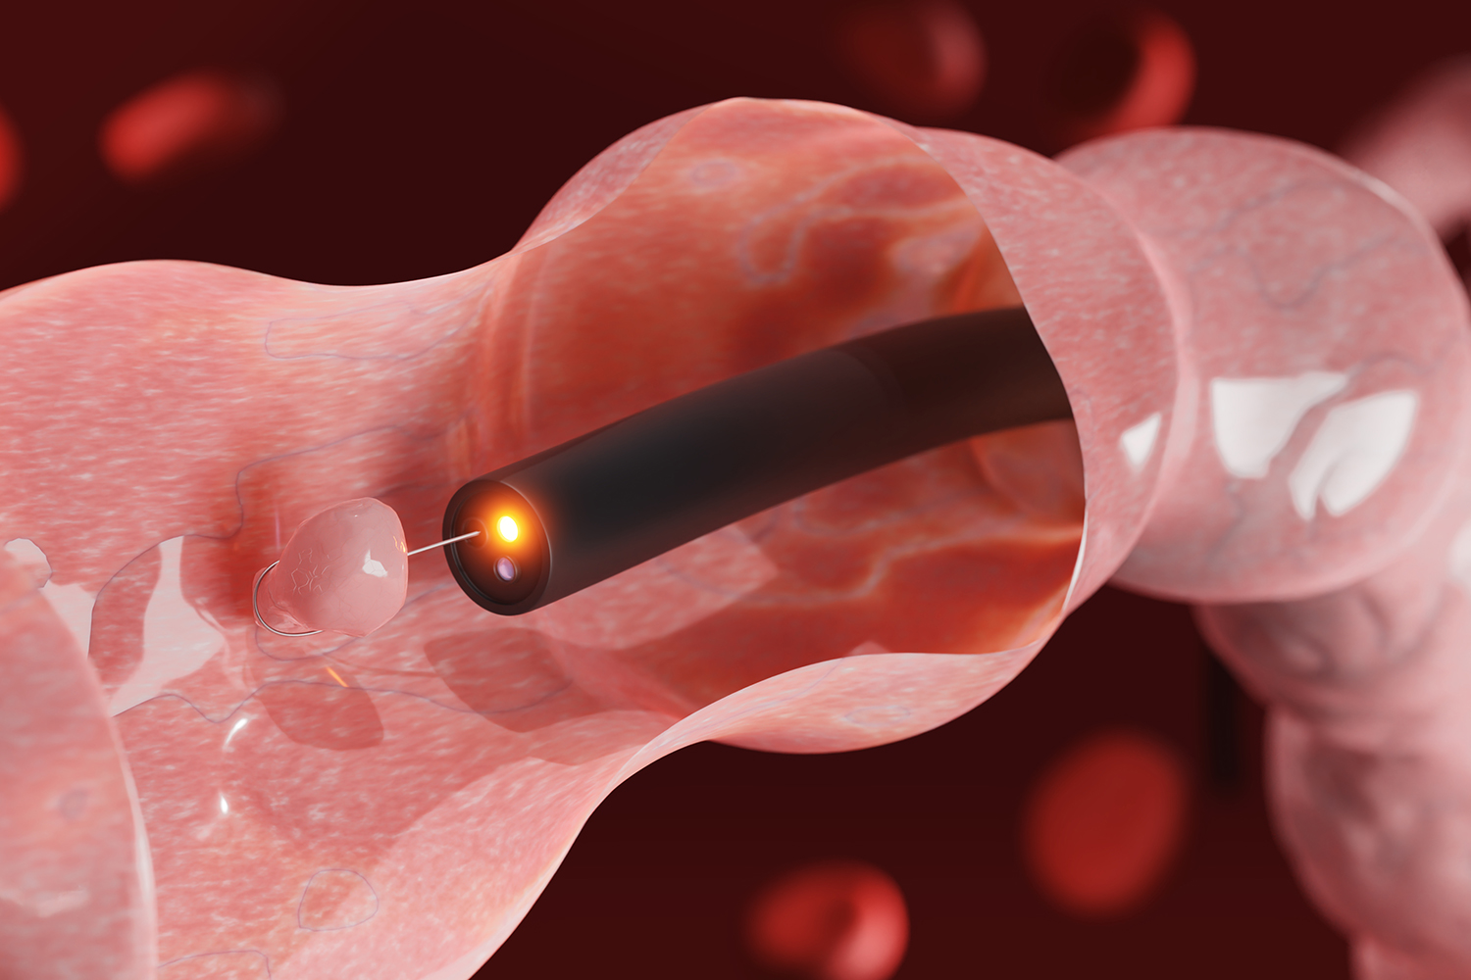
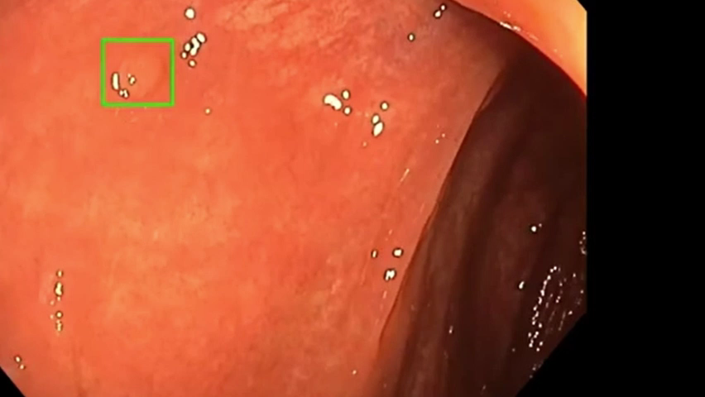
I- Introduction
II- Methodology
III- Results & Discussion
IV- Conclusion
Purpose:
This presentation covers my master's thesis project, focusing on using AI and advanced computer vision techniques to improve endoscopic procedure analysis.
Importance:
Endoscopy is a crucial tool in medical diagnostics, but it faces challenges such as missed anomalies and variability in examination quality. Integrating AI can significantly enhance the accuracy and efficiency of these procedures.
PFE Master Computer and Mobile Systems
Notes:
The purpose of this presentation is to share the findings and advancements from my master's thesis project. Specifically, we focus on using AI and advanced computer vision techniques to improve endoscopic procedure analysis.

Slide 3
I
Introduction
II
Methodology
Overview
III
Results and Discussion
IV
Conclusion
3
PFE Master Computer and Mobile Systems
Notes:
Here's an overview of the presentation. We'll begin with an introduction, followed by the methodology employed in this study. Then, we'll move on to the results and discussion, and finally, conclude with our key findings and implications.

Slide 4
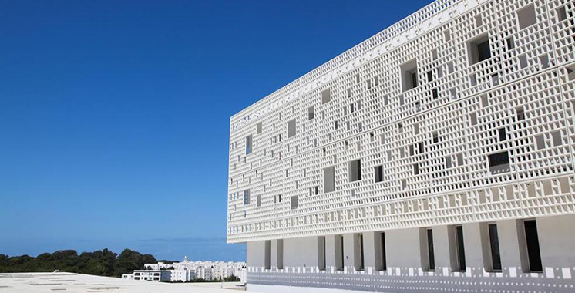
I- Introduction
II- Methodology
III- Results & Discussion
IV- Conclusion
Company Overview
CHU Mohammed VI of Tangier
Localisation and Population Served:
Region: Tangier-Tetouan-Al Hoceima, spanning 17,262 km².
Population: Approximately 3.56 million.
Geography: Bordered by the Strait of Gibraltar, the Mediterranean Sea, and the Atlantic Ocean.
Missions and Values
Healthcare
Education
Research
Public Health
Core Values
PFE Master Computer and Mobile Systems

Slide 5
I- Introduction
II- Methodology
III-Results & Discussion
IV- Conclusion
Company Overview
CHU Mohammed VI of Tangier
IT Department
Responsibilities:
Role: Manages and develops hospital information systems and technologies
Managing Technological Infrastructure
Developing and maintaining Infrastructure
Providing Technical support
Ensuring data security
Overseeing technological projects
PFE Master Computer and Mobile Systems

Slide 6
I- Introduction
II- Methodology
III-Results & Discussion
IV- Conclusion
Problem Statement & Key Challenges
High Undetected Anomalies: Endoscopic procedures often miss anomalies due to the complex nature of the video footage and high variability in anatomical structures.
Suboptimal Detection Rates: The current manual review process is prone to errors, leading to missed diagnoses and delayed treatments.
Need for Advanced Tools: There is a critical need for robust, automated solutions to assist clinicians in detecting anomalies more accurately and efficiently.
Objective: To develop AI models that enhance endoscopic video analysis, improving diagnostic accuracy, and providing reliable support for medical professionals.
Complex and Messy Videos: The dynamic nature and variability of endoscopic videos make it difficult to maintain high detection accuracy.
High Missed Anomalies: Significant percentage of anomalies go undetected, affecting patient outcomes.
Manual Review Limitations: Reliance on human perception leads to inconsistent and sometimes inaccurate diagnoses.
PFE Master Computer and Mobile Systems
Notes:
Endoscopic procedures often miss anomalies due to the complex nature of the video footage and high variability in anatomical structures.
There is a critical need for robust, automated solutions to assist clinicians in detecting anomalies more accurately and efficiently.
Therefore, our objective is to develop AI models that enhance endoscopic video analysis, improving diagnostic accuracy and providing reliable support for medical professionals.

Slide 7

I- Introduction
II- Methodology
III-Results & Discussion
IV- Conclusion
Research Objectives
Develop AI Models for Endoscopic Image Processing
Enhance Diagnostic Accuracy
Create User-Friendly Interfaces for Clinical Use
PFE Master Computer and Mobile Systems

Slide 8
I- Introduction
II- Methodology
III-Results & Discussion
IV- Conclusion
CRISP-DM Framework
CRISP-DM
Business Understanding
Define project objectives and requirements.
Data Understanding
Collect and familiarize with initial data.
Identify data quality issues.
Data Preparation
Clean and transform raw data for modeling.
Modeling
Select and apply various algorithms.
Fine-tune models for optimal performance.
Evaluation
Assess model performance using predefined metrics.
Deployment
Develop user-friendly interfaces for practical application.
PFE Master Computer and Mobile Systems

Slide 9
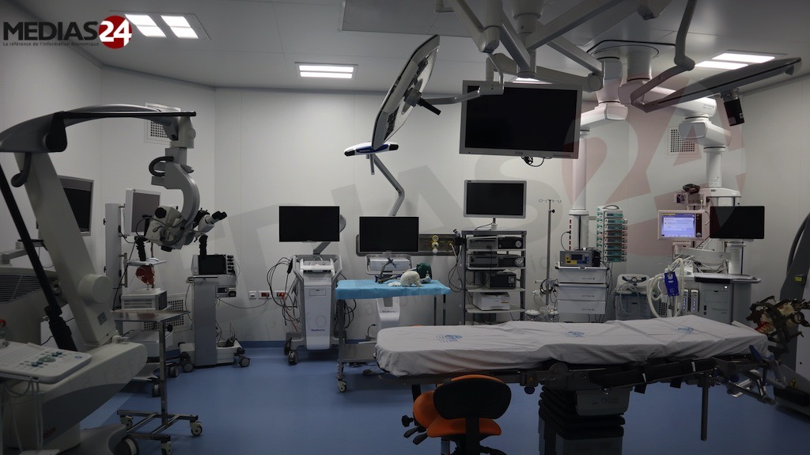


I- Introduction
II- Methodology
III-Results & Discussion
IV- Conclusion
Data Collection
Sources:
Clinical Collaborations
Online Repositories
Data Annotation Processes:
Medical Professionals
PFE Master Computer and Mobile Systems
Notes:
For data collection, we collaborated with clinical partners and utilized online repositories. The data annotation processes were conducted by medical professionals to ensure accuracy and reliability.

Slide 10
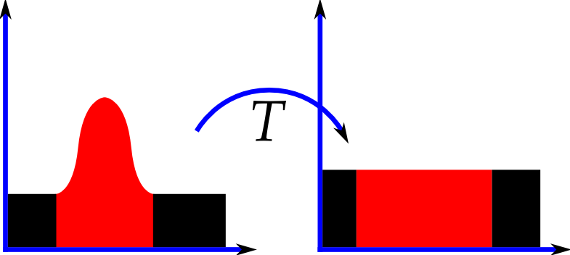
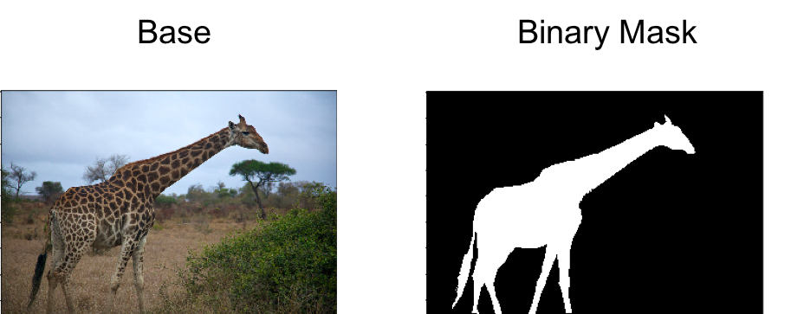
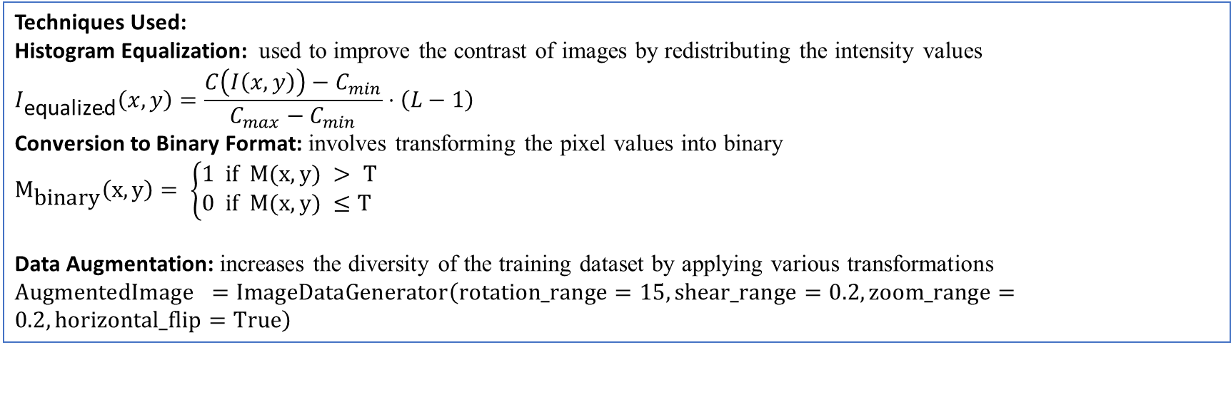
I- Introduction
II- Methodology
III-Results & Discussion
IV- Conclusion
Data Preprocessing
Techniques Used:
Histogram Equalization: used to improve the contrast of images by redistributing the intensity values
$$I_{\text{equalized}}\left(x,y\right)=\frac{C\left(I\left(x,y\right)\right)−C_{min}}{C_{max}−C_{min}}⋅\left(L−1\right)$$
Conversion to Binary Format: involves transforming the pixel values into binary
$M_{\text{binary}}\left(x,y\right)= \left\{\begin{aligned}1 & if M(x, y) > T \\ 0 & if M(x, y) ≤T\end{aligned}\right.$
Data Augmentation: increases the diversity of the training dataset by applying various transformations
$\text{AugmentedImage} =\text{ImageDataGenerator}\left(\text{rotation}\text{_}\text{range}=15,\text{shear}\text{_}\text{range}=0.2,\text{zoom}\text{_}\text{range}=0.2,\text{horizontal}\text{_}\text{flip}=\text{True}\right)$
PFE Master Computer and Mobile Systems
Notes:
Data preprocessing involved several essential techniques to enhance the quality and usability of our data for model training:
By doing so, it enhances the visibility of features and details in the images, making them more suitable for analysis.
Involves transforming pixel values into a binary format. This process simplifies the image by converting it into a binary mask where each pixel is either a ‘1
This technique increases the diversity of the training dataset by applying various transformations to the images. These transformations can include rotations, shifts, flips, zooms, and other modifications that create new variations of the existing images.

Slide 11
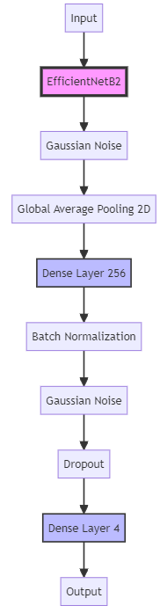
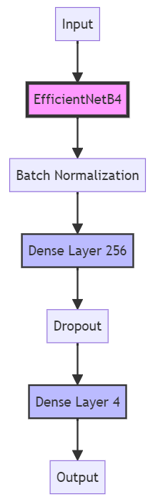

I- Introduction
II- Methodology
III-Results & Discussion
IV- Conclusion
Model Development: Classification Models
EfficientNetB4:
Chosen for superior performance in endoscopic image classification.
Architecture includes MBConv layers and the Swish activation function.
Compound scaling for depth, width, and resolution.
Trained with data augmentation and normalization techniques.
EfficientNetB2:
Lightweight model for efficient and effective classification.
Utilizes compound scaling for balanced network dimensions.
Key features include MBConv layers, depthwise separable convolutions, and squeeze-and-excitation optimization.
PFE Master Computer and Mobile Systems
Notes:
We developed two classification models: EfficientNetB2 and EfficientNetB4. EfficientNetB2 is a lightweight model designed for efficient and effective classification, while EfficientNetB4 offers superior performance for endoscopic image classification, utilizing advanced architecture and training techniques.

Slide 12

I- Introduction
II- Methodology
III-Results & Discussion
IV- Conclusion
Model Development: Segmentation Models
DeepLabv3+ with ResNet50 Backbone:
Captures multi-scale contextual information.
Utilizes Atrous Spatial Pyramid Pooling (ASPP).
Decoder module refines segmentation accuracy.
Transformer-Based Segmentation Model:
Captures long-range dependencies with self-attention.
Positional encoding for spatial information.
Effective for endoscopic image segmentation.
UNet-Based Segmentation Models:
Symmetric encoder-decoder architecture.
Precise localization and segmentation.
Combines convolutional blocks with upsampling layers.
PFE Master Computer and Mobile Systems
Notes:
For segmentation, we employed models such as DeepLabv3+ with a ResNet50 backbone, Transformer-Based Segmentation Models, and UNet-Based Segmentation Models. These models capture multi-scale contextual information, long-range dependencies, and precise localization and segmentation.

Slide 13
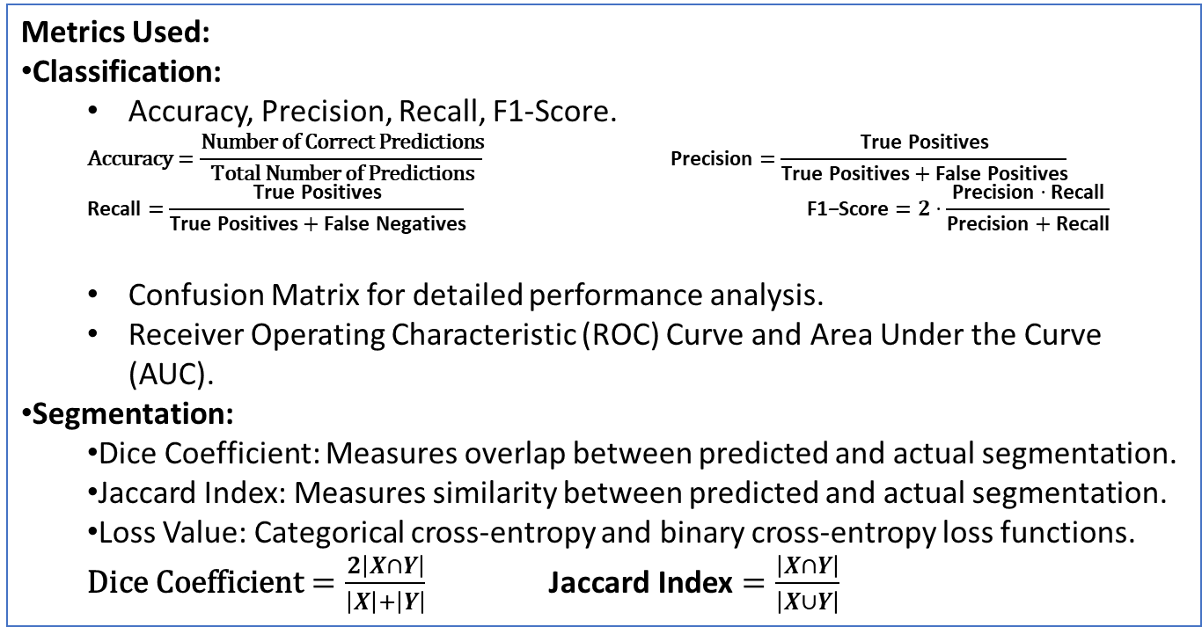
I- Introduction
II- Methodology
III-Results & Discussion
IV- Conclusion
Model Evaluation
Metrics Used:
Classification:
Accuracy, Precision, Recall, F1-Score.
$$\text{Accuracy}=\frac{\text{Number} \text{of} \text{Correct} \text{Predictions}}{\text{Total} \text{Number} \text{of} \text{Predictions}} \text{Precision}=\frac{\text{True} \text{Positives}}{\text{True} \text{Positives}+\text{False} \text{Positives}}$$
$$\text{Recall}=\frac{\text{True} \text{Positives}}{\text{True} \text{Positives}+\text{False} \text{Negatives}} \text{F}\text{1}\text{−}\text{Score}=2⋅\frac{\text{Precision}⋅\text{Recall}}{\text{Precision}+\text{Recall}}$$
Confusion Matrix for detailed performance analysis.
Receiver Operating Characteristic (ROC) Curve and Area Under the Curve (AUC).
Segmentation:
Dice Coefficient: Measures overlap between predicted and actual segmentation.
Jaccard Index: Measures similarity between predicted and actual segmentation.
Loss Value: Categorical cross-entropy and binary cross-entropy loss functions.
$\text{Dice} \text{Coefficient}=\frac{2\left|X∩Y\right|}{\left|X\right|+\left|Y\right|}$ $\text{Jaccard} \text{Index}=\frac{\left|X∩Y\right|}{\left|X∪Y\right|}$
Benchmarking:
Evaluated on the same test set for consistency.
Compared using classification accuracy, confusion matrix, and segmentation metrics.
Demonstrated improvements over baseline and advanced techniques.
PFE Master Computer and Mobile Systems
Notes:
Now let's move on to the model evaluation metrics. For the classification models, we used several key metrics including accuracy, precision, recall, and F1-score.
For segmentation models, we focused on the Dice Coefficient, which measures the overlap between predicted and actual segmentation, and the Jaccard Index, which measures the similarity between predicted and actual segmentation. We also considered the loss value using categorical cross-entropy and binary cross-entropy loss function.
Benchmarking was conducted on the same test set for consistency, and we compared using classification accuracy, confusion matrix, and segmentation metrics, demonstrating improvements over baseline and advanced techniques

Slide 14


I- Introduction
II- Methodology
III-Results & Discussion
IV- Conclusion
Realization and Deployment
Model Saving and Preparation
Exported using model-saving functionalities.
Ensures portability and ease of integration.
Developing User-Friendly Interface
Developed a web application using Gradio.
Presented at the National Endoscopy Congress.
PFE Master Computer and Mobile Systems
Notes:
For the realization and deployment of our models, we focused on model saving and preparation. We exported the models using model-saving functionalities to ensure portability and ease of integration. We also developed a user-friendly interface using Gradio. This web application was presented at the National Endoscopy Congress, allowing clinicians to easily interact with and benefit from our models.

Slide 15
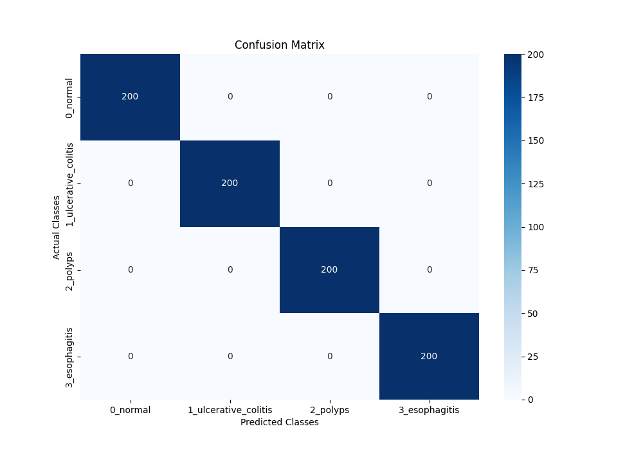
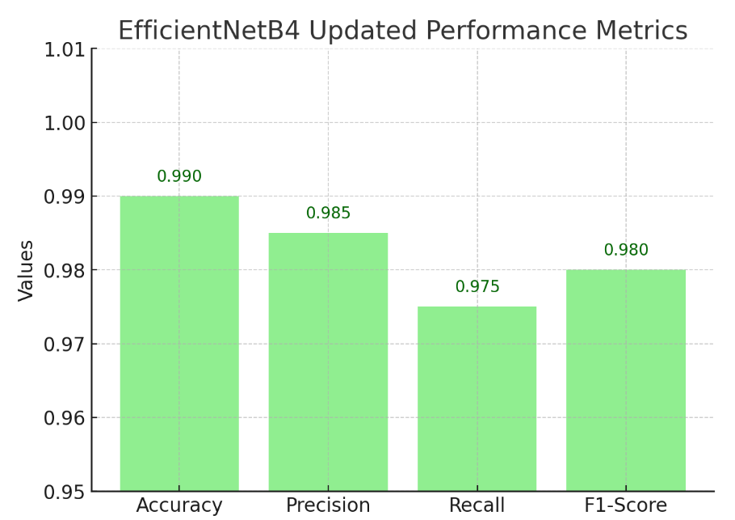
I- Introduction
II- Methodology
III-Results & Discussion
IV- Conclusion
Results
Key Findings:
Improved Diagnostic Accuracy:
EfficientNetB4 achieved exceptional accuracy in classifying endoscopic images.
Significant improvement in the detection rates of anomalies such as polyps and esophagitis.
PFE Master Computer and Mobile Systems
Notes:
Our key findings showed improved diagnostic accuracy, where the EfficientNetB4 model achieved exceptional accuracy in classifying endoscopic images, significantly improving the detection rates of anomalies such as polyps and esophagitis. The confusion matrix and performance metrics highlight this improvement

Slide 16
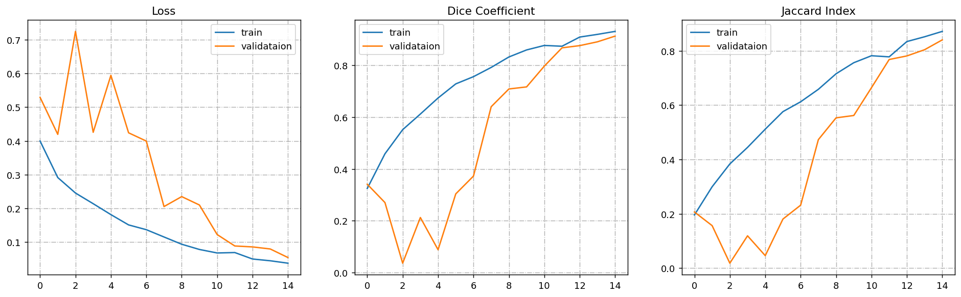
I- Introduction
II- Methodology
III-Results & Discussion
IV- Conclusion
Results
Key Findings:
Effective Segmentation:
DeepLabv3+ with ResNet50 provided high-quality segmentation results.
Essential for precise localization of abnormalities in endoscopic images.
Real-Time Decision Support:
Models capable of providing real-time analysis and feedback.
Crucial for assisting clinicians during endoscopic procedures.
PFE Master Computer and Mobile Systems
Notes:
Effective segmentation was achieved using DeepLabv3+ with the ResNet50 backbone, providing high-quality segmentation results essential for the precise localization of abnormalities in endoscopic images. Additionally, our models are capable of providing real-time decision support, offering crucial assistance to clinicians during endoscopic procedures by providing real-time analysis and feedback.

Slide 17
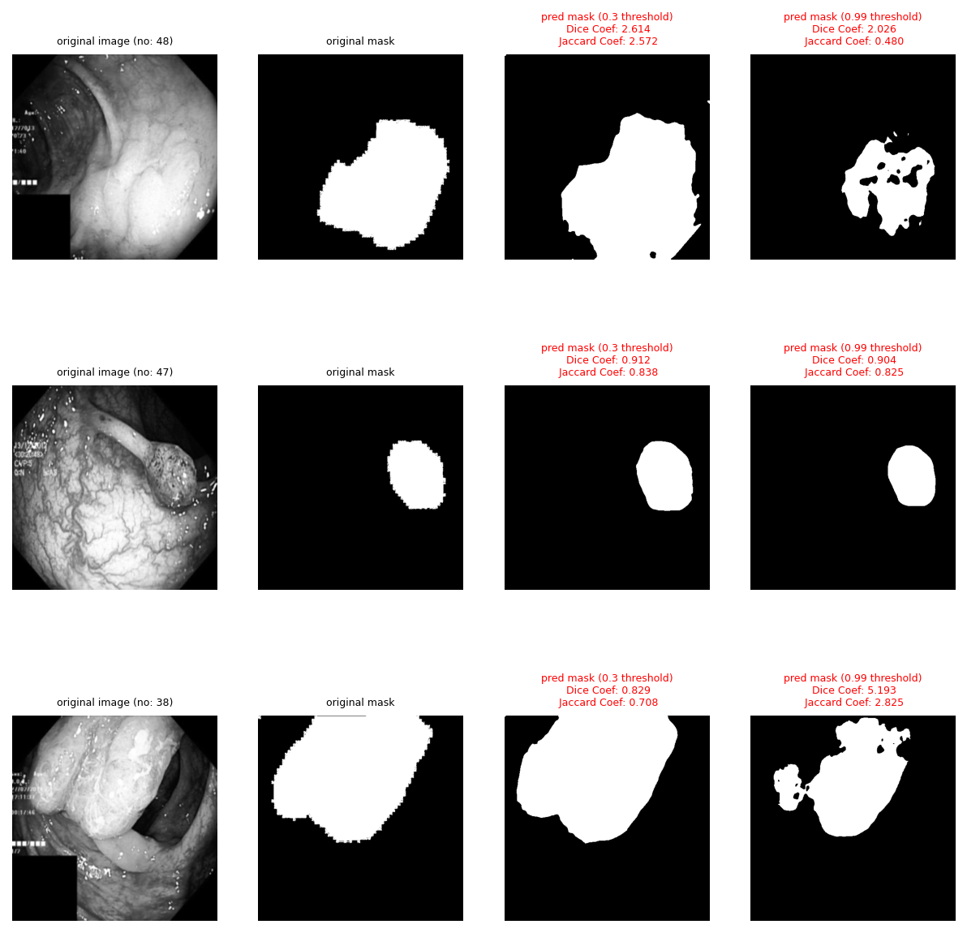
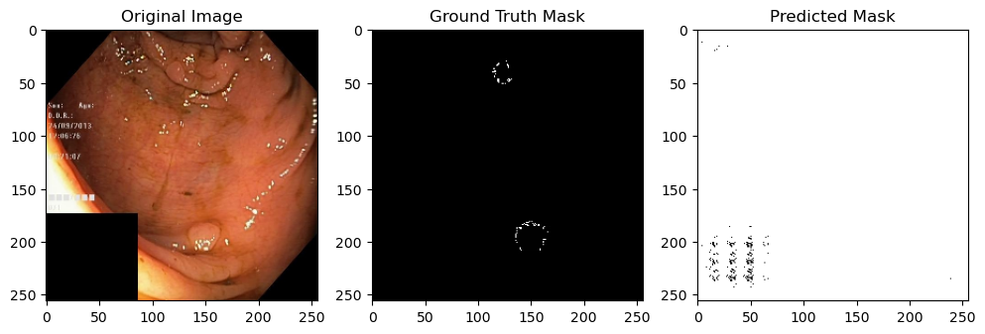
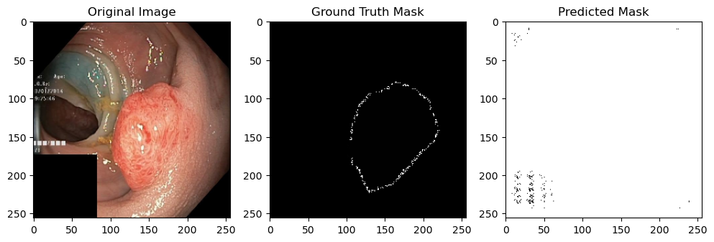
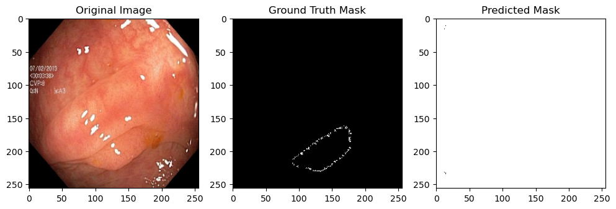
I- Introduction
II- Methodology
III-Results & Discussion
IV- Conclusion
Results
PFE Master Computer and Mobile Systems
Notes:
Here, you can see visual demonstrations of our segmentation results. The original images are compared with the ground truth masks and predicted masks, illustrating the effectiveness of our models in accurately identifying and segmenting abnormalities

Slide 18
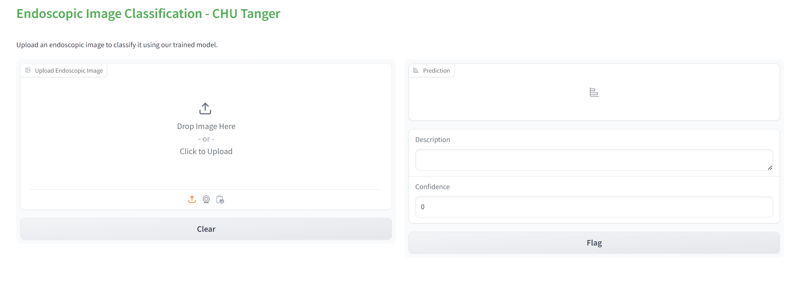
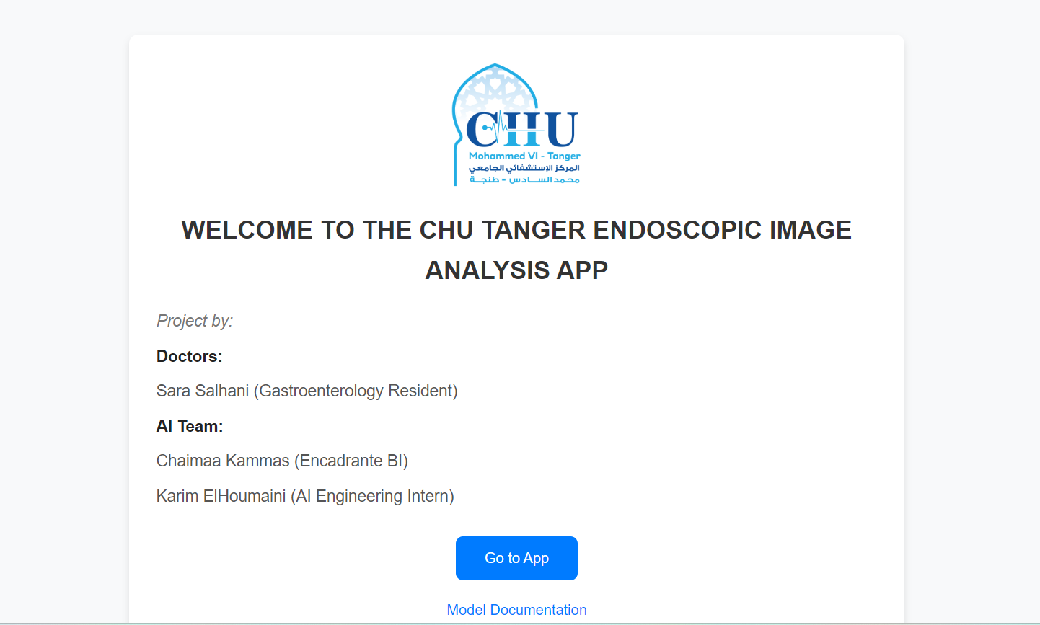
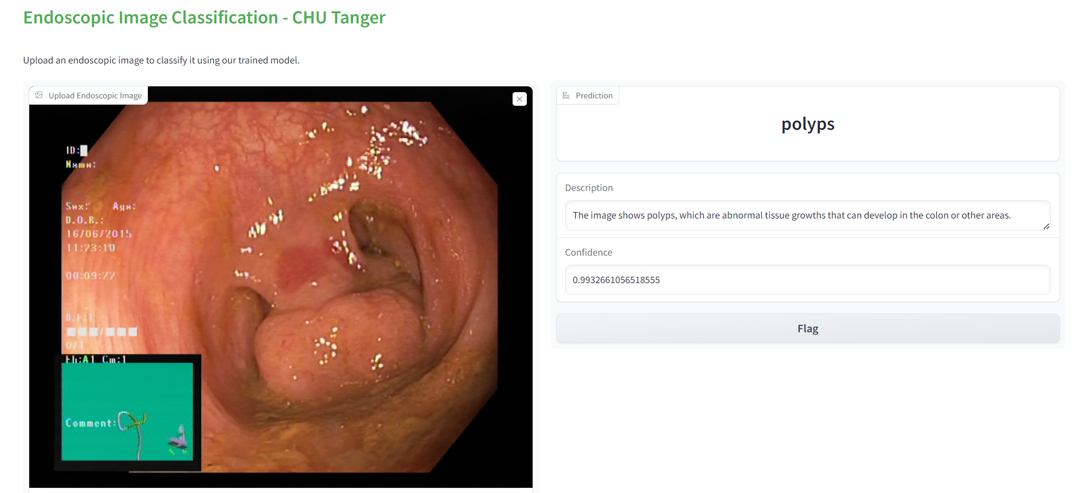
I- Introduction
II- Methodology
III-Results & Discussion
IV- Conclusion
Results
PFE Master Computer and Mobile Systems
Notes:
Our developed application interface allows clinicians to upload endoscopic images for classification and analysis. The interface provides detailed predictions and confidence scores, making it an invaluable tool for clinical use

Slide 19
I- Introduction
II- Methodology
III-Results & Discussion
IV- Conclusion
Conclusion & outlook
Key Achievements:
Improved diagnostic accuracy.
Effective segmentation using advanced AI models.
Developed a user-friendly interface presented at a national congress.
Future Work:
Apply models to endoscopic videos.
Full clinical deployment and integration.
Explore other medical imaging modalities.
PFE Master Computer and Mobile Systems
Notes:
In conclusion, our project has achieved significant milestones, including improved diagnostic accuracy, effective segmentation using advanced AI models, and the development of a user-friendly interface presented at a national congress. Looking forward, future work will involve applying our models to endoscopic videos, achieving full clinical deployment and integration, and exploring other medical imaging modalities to further enhance diagnostic capabilities.

Slide 20
I- Introduction
II- Methodology
III-Results & Discussion
IV- Conclusion
Q&A and Acknowledgements
Q&A Session
Questions: Please feel free to ask about the project, methodology, results, or future work.
Acknowledgements
Supervisors:
Pr. Zouhair Abdelhamid
Kammas Chaimaa
Collaborators:
CHU Tangier
Faculty of Sciences and Techniques at Tangier (FSTT)
Supporters:
Pr. EL BRAK Mohamed
Pr. EN-NAIMI el mokhtar
Thank You!
Contact Information:
Email: elhoumaini.ka@gmail.com
LinkedIn : linkedin.com/in/karim-elhoumaini
PFE Master Computer and Mobile Systems
Notes:
Finally, I would like to open the floor for any questions. Please feel free to ask about the project, methodology, results, or future work. I would also like to take this opportunity to thank my supervisors, collaborators, and supporters who have contributed to the success of this project. Thank you all for your attention

Slide 21
ENHANCING ENDOSCOPIC PROCEDURE ANALYSIS
A COMPREHENSIVE STUDY ON ANOMALY DETECTION, SEGMENTATION, AND REAL-TIME DECISION SUPPORT SYSTEMS
Master Internship
Master in Science and Technology: Computer and Mobile Systems
KARIM EL HOUMAINI
Project supervised by: Pr. ZOUHAIR Abdelhamid
KAMMAS Chaimaa, BI Supervisor
Notes:
Finally, I would like to open the floor for any questions. Please feel free to ask about the project, methodology, results, or future work. I would also like to take this opportunity to thank my supervisors, collaborators, and supporters who have contributed to the success of this project. Thank you all for your attention

